Slide 1
Group Project Level 4/5 Group 1
Aaron K Benjamin A,
George F Joe W

Slide 2
Logline
2D puzzle platformer where the player must follow another survivor while avoiding the perils of a hostile environment by solving puzzles.

Slide 3
Target Audience
Male and female (Mostly males)
Aged between 16-28
Have an interest in puzzles, old school games and narrative

Slide 4
Emotions
Chrysalism: The amniotic tranquility of being indoors during a thunderstorm.
Adronitis: Frustration with how long it takes to get to know someone.

Slide 5
Mechanics
Platformer
Jumping
Player Movement
Item Collection
Enemies
Non violent approach to dealing with levels
No weapons
Using puzzles to dispatch enemies

Slide 6
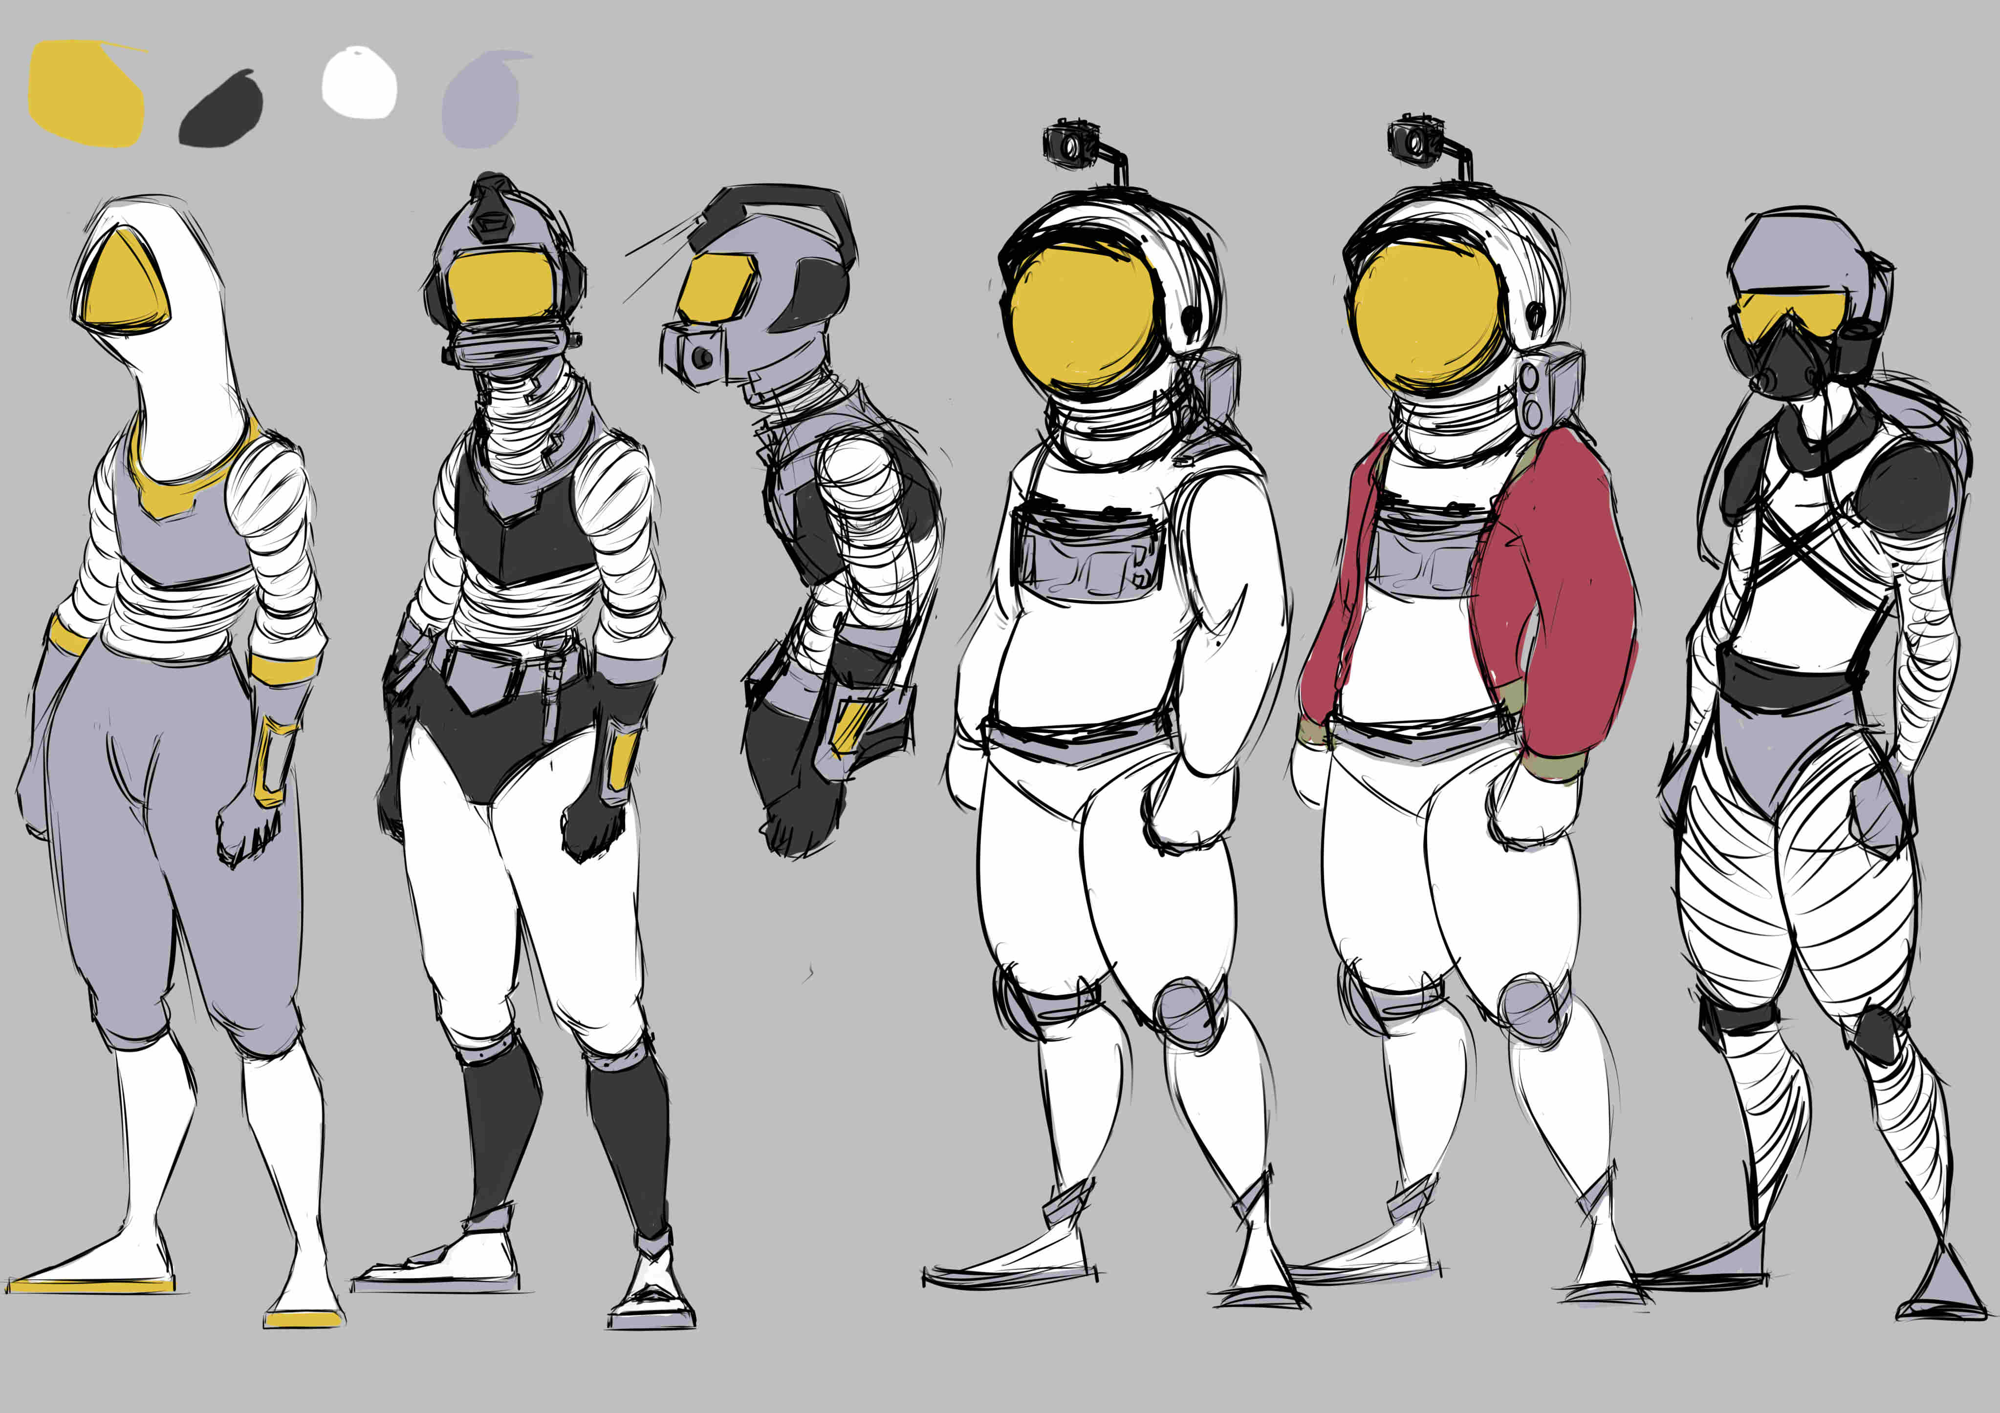
Character Design
Astronaut / Diver

Slide 7
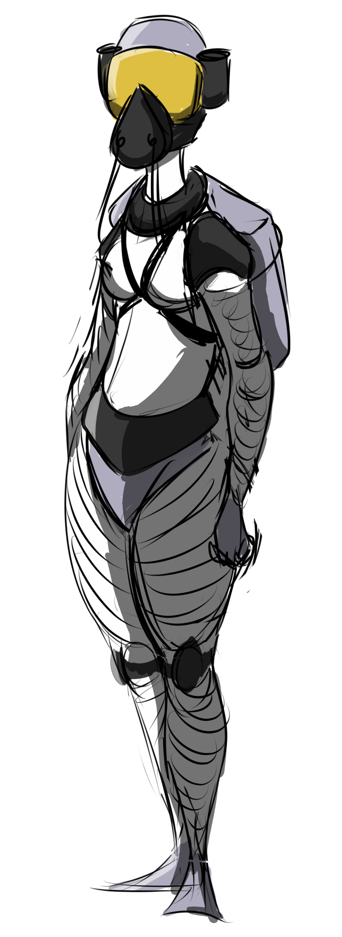
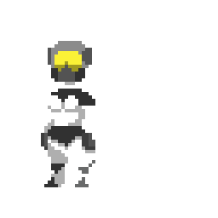
Character Design
Survivor
Female
Maternal
Sex

Slide 8
Character Design
Enemies

Slide 9
How Mechanics reinforce the emotions
Outside world is hostile
Obstacles in the form of avoiding the enemies
Stops player from getting to survivor they’re chasing
Builds frustration
Indoors is calm
Conflict with the enemies outside builds tension
Tension is released Indoors reinforcing the calm
Contrasts the hostile outside

Slide 10
Interior
Calm
Place to pause after frustration of outside
Reinforces harshness of the outside
Tells a story of past survivor

Slide 11
Outside

Slide 12
The Game

Slide 13
Group Management
Hours logged so far
Aaron
24h
Ben
25h
George
26h
Joe
23h

Slide 14
What next?
Finalise Visuals
Art assets
Animations
Sounds
Build the first level
Complete the first level…
Playtest
…and get people to playtest it.

Slide 15
Questions?

